Slide 1








PRESENTATION
DMAC-101
By Harshit Singh, Esha Arun, Anirudh Kuruvanthody

Slide 2
LIFE CARRIER: SEED STARTER TRAY & SEEDLING PLANTER
SUBTITLE: REVOLUTIONIZING ECO-FRIENDLY
Planting SOLUTIONS
PRESENTED BY: HARSHIT SINGH, ESHA ARUN,
ANIRUDH KURUVANTHODY
GROUP NO. - 10 (3 MEMBER)
PRODUCT - ECO-FRIENDLY ALTERNATIVE
DATE: 21/12/2024

Slide 3
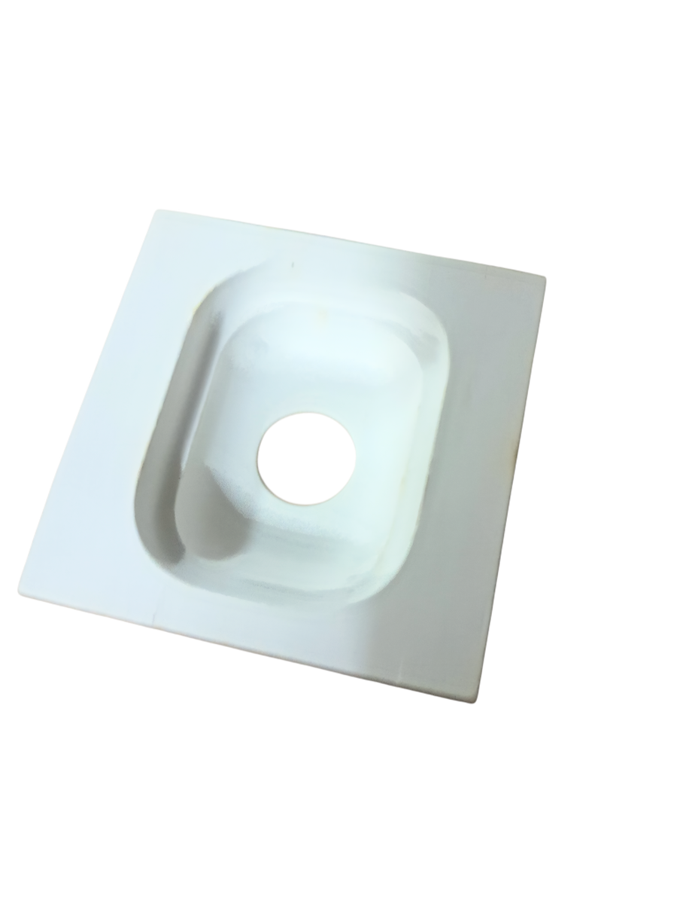
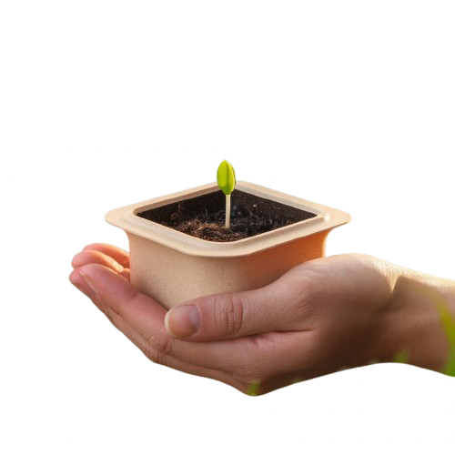
Product Description
What is Life Carrier?
Life Carrier is an eco-friendly seed starter tray that simplifies planting while contributing to sustainability and plant health.
Material: Made from natural plant fibers, grasses, and biodegradable materials, which break down in the soil, enriching it with organic matter.
How to Use: Simply place the tray in a pot or directly on soil, plant the seeds, and water. The tray will decompose naturally, adding essential nutrients to the soil.
Impact:
Reduces the use of plastic seed trays.
Contributes to healthier soil ecosystems.
Encourages sustainable practices in gardening and agriculture.

Slide 4

WHY THE NAME LIFE CARRIER? LOGO & TAGLINE
Why Life Carrier?
The name signifies the product's role in nurturing young plants by carrying life in its early stages.
It emphasizes portability, simplicity, and sustainability for urban gardeners and eco-conscious consumers.
Logo Description:
An abstract icon representing a sprouting plant emerging from a square base, symbolizing the tray.
A monochromatic green palette to reinforce eco-friendliness and sustainability.
Clean, bold sans-serif font for "Life Carrier," reflecting modernity and simplicity.
Tagline - "Nurturing Life, Naturally."

Slide 5
WHY PEOPLE USE IT
Benefits of Life Carrier:
Sustainability: Made from 100% biodegradable materials, it decomposes naturally, enhancing soil fertility.
Convenience: Simple to use – plant directly into the ground without transferring seedlings.
Environmental Impact: Reduces plastic waste and supports eco-friendly gardening practices.
Cost-Effective: An affordable alternative for gardeners and large-scale planting projects.
Healthy Plant Growth: The tray prevents root damage, ensuring robust plant development.

Slide 6
BRAND POSITIONING STATEMENT
Positioning Statement:
"Life Carrier empowers eco-conscious consumers to embrace sustainable planting with a biodegradable, nutrient-rich tray that nurtures life while protecting the planet."
Key Elements of Positioning:
Eco-Friendliness: Highlights the sustainable materials and decomposing benefits.
Practicality: Focused on ease of use for gardeners and planters.
Environmental Contribution: Encourages responsible consumption by replacing plastic products.

Slide 7
4 Main Consumer Segments
Urban Gardeners
Educational Institutions
1.
Individuals living in apartments or homes with limited outdoor space who enjoy growing herbs, flowers, and small plants. They prioritize eco-friendly and space-efficient gardening solutions.
2.
Schools implementing hands-on learning projects in biology or environmental science, where gardening can teach sustainability and plant life cycles.
Nurseries & Farmers:
Eco-Conscious Consumers:
3.
Professionals germinating seedlings in large volumes, looking for cost-effective and biodegradable solutions that eliminate plastic waste.
4.
Environmentally aware individuals seeking sustainable products for their hobbies or lifestyles, such as home gardening or urban farming.
Other potential consumer segments to explore include.....
Organic Farming Enthusiasts:
CSR (Corporate Social Responsibility) Programs
5.
6.
Community Gardening Projects:
7.

Slide 8


Urban Gardener
Demographics: Priya is a 23 years old, software engineer, lives in a city apartment with limited space.
Goal: To grow herbs and flowers on her balcony to reduce her reliance on store-bought produce and beautify her space.
Pain Points:
Limited space for gardening tools and planters.
Concern about the environmental impact of using plastic gardening products.
Lack of time to constantly attend to the plant and provide it extra nutrition.
Buying Behavior:
Prefers Compact, and cost-effective products.
Shops online through marketplaces like Amazon, blinkit.
Is influenced by social media promotions and ads to by new products
Rational & example
Urban areas are experiencing a rise in gardening as a hobby, driven by the need to connect with nature and grow food sustainably in small spaces.
Urban Harvest in Houston promote rooftop gardening, and individuals like Ron Finley (the "Gangsta Gardener") inspire others to transform small urban areas into lush, productive gardens.
Looking for a convinient and compact solution to grow her garden within the limited space of her city apartment

Slide 9

Educator
Demographics: Rajveer is a 35 years old, biology teacher in a middle school.
Goal: To teach students about sustainability, plant growth/lifecycle, and the importance of reforestation through hands-on activities.
Pain Points:
Lack of affordable and easy-to-use gardening kits for classroom use.
Difficulty sourcing biodegradable and kid-friendly products.
Compact gardening solutions that dosen’t create a mess in the classroom.
Buying Behavior:
Looks to bulk-buy options and educational kits.
Purchases through institutional suppliers or local vendors.
Rational & example
Schools and parents are looking for hands-on tools to teach children about sustainability and the life cycle of plants, making this product ideal for educational use.
Programs like the Junior Master Gardener Program incorporate sustainable gardening into their curriculum to engage kids in eco-conscious activitie
Someone seeking affordable, kid-friendly gardening kits and biodegradable products for hands-on classroom activities.

Slide 10
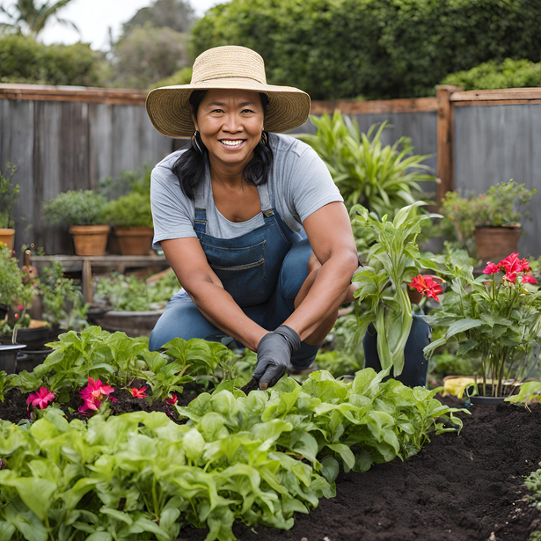
Nursery Owner
Demographics: Shriya, 42 years old, owner of a small nursery that grows herbs.
Goal: To grow seedlings in a cost-effective and eco-friendly way to meet increasing demand for her plants.
Pain Points:
Need to replace plastic trays that customers criticize for environmental reasons.
Wants a product that simplifies transplantation to minimize plant loss.
Buying Behavior:
Orders in bulk from agricultural suppliers or eco-friendly distributors.
Rational & example
Nurseries and farmers require affordable solutions for large-scale seedling production while minimizing their ecological footprint.
Companies like Botanicare and community initiatives such as local farmer co-ops often emphasize the cost-effectiveness and environmental benefits of using biodegradable materials.
Nursery owner that wants to grow seedlings cost-effectively and sustainably, looking to replace plastic trays while also improving efficiency.

Slide 11

Eco-Conscious Enthusiast
Demographics: 30 years old, freelancer with a passion for sustainability.
Goal: To use products that align with her zero-waste lifestyle while creating a home garden.
Pain Points:
Limited options for sustainable gardening tools.
Desire for aesthetically pleasing and functional products.
Wants to avoid the messy and physically taxing traditional gardening tools
Buying Behavior:
Prefers niche eco-friendly brands and is willing to pay a premium for quality.
Goes to eco friendly events and markets, shops both online and offline stores
She also writes and talks about her eco friendly product finds to her friends
Rational & example
Increasing consumer awareness about plastic waste and environmental impact is driving the demand for biodegradable and compostable products.
Brands like Coco & Coir specialize in eco-friendly gardening tools and have gained traction with their biodegradable pots and coir-based products, illustrating the rising preference for sustainable alternatives.
Someone that prioritizes zero-waste living, seeks aesthetically pleasing, sustainable gardening tools, and values quality over cost .

Slide 12
DIFFERENTIATORS
How Life Carrier Stands Out:
Material: Made from 100% biodegradable, nutrient-rich fibers that naturally decompose in the soil.
Market Gap: Addresses the need for affordable, sustainable alternatives in gardening.
Competitive Edge: Simplifies planting, promotes environmental sustainability, and enhances soil health.
Competitors:
Plastic seed trays.
Expensive paper-based or ceramic planters.

Slide 13
Consumer Insights
Popluarity of asthetics
Hobby gardening
Education tool
The increasing popularity of home gardening during recent years has led to greater interest in gardening products among millennials and Gen Z consumers. These demographics often seek out trendy and aesthetically pleasing gardening solutions that fit their lifestyle
Many gardeners, especially beginners, struggle with transplanting seedlings. This product’s direct-planting feature eliminates this challenge and reduces root damage.
For example, the company Seedlingers offers beginner-friendly gardening kits that simplify planting processes, making it easier for hobbyists to succeed.
Educational institutions are increasingly incorporating gardening into their curricula to teach students about sustainability and biology. The seed starter tray serves as an effective tool for hands-on learning experiences

Slide 14
TARGET AUDIENCE
Primary Audience:
Eco-conscious urban residents aged 18-45.
Small businesses promoting sustainability.
Secondary Audience:
Schools, nurseries, gardening communities, and NGOs involved in reforestation or educational projects.
Appeal to Target Audience:
Highlight eco-friendliness, convenience, and affordability.
Show direct benefits to their gardens and the environment.

Slide 15
BUSINESS PROBLEM & DIGITAL MARKETING OBJECTIVES
Business Problem:
Gardening products often rely on plastic, contributing to waste.
Lack of affordable, biodegradable alternatives in the market.
Digital Marketing Objectives:
Build brand awareness among urban and eco-conscious consumers.
Drive traffic to e-commerce platforms and increase sales.
Engage with audiences through interactive digital campaigns.
Foster customer loyalty and advocacy through meaningful interactions.

Slide 16
CONSUMER PATHWAY & KPIS
Awareness: Introduce potential customers to the brand and product.
Tactics: Social media ads (Instagram, Facebook), influencer collaborations, display ads.
KPIs: Reach, impressions, click-through rates (CTR).
Consideration: Educate the audience on the benefits and features of Life Carrier.
Tactics: Blog posts, educational video content, customer reviews.
KPIs: Website visits, time spent on site, bounce rate.
Purchase: Convert interested users into paying customers.
Tactics: E-commerce site, discounts, limited-time offers.
KPIs: Conversion rate, cost per acquisition (CPA), sales volume.
Loyalty: Retain customers and build long-term relationships.
Tactics: Email marketing, personalized offers, loyalty programs.
KPIs: Repeat purchase rate, customer retention, email open rates.
Advocacy: Encourage customers to promote the brand to others.
Tactics: Referral programs, user-generated content (UGC), social media sharing.
KPIs: Shares, referrals, Net Promoter Score (NPS), reviews.

Slide 17
CREATIVE BRIEF WITH SMP
Single-Minded Proposition (SMP):
"Life Carrier makes planting simple, eco-friendly, and impactful for everyone."
Creative Brief:
Objective: To position Life Carrier as the preferred choice for sustainable gardening.
Target Audience: Eco-conscious urbanites aged 18-45.
Insight: Planting can be sustainable, affordable, and effortless.
Tone: Empowering, eco-friendly, and approachable.

Slide 18
SEARCH KEYWORDS
Keywords for SEO & SEM:
High Intent Keywords:
“Biodegradable seed starter trays.”
“Eco-friendly gardening tools.”
Broader Keywords:
“Sustainable planting solutions.”
“Best seedling trays for herbs.”
Transactional Keywords:
“Buy seed trays online.”
“Affordable biodegradable planters.”

Slide 19
INFLUENCER PROGRAM & DIGITAL ADS
Collaborate with eco-conscious influencers and bloggers in the gardening and sustainability niches.
Example: Partner with influencers who showcase their own gardening journey, using the Life Carrier tray to start their seeds.
Benefits:
Credibility through third-party validation.
Reach to a highly targeted audience that aligns with eco-friendly values.
Engagement through authentic content such as tutorials and reviews.
Digital Ads:
Platforms: Instagram, Facebook, Google Ads.
Instagram & Facebook Ads: Visuals of Life Carrier in use, with text highlighting sustainability, convenience, and ease of use.
Google Ads: Target searches for "eco-friendly seed starter trays" or "sustainable gardening tools."
Content: Videos or carousel ads showing the product in action, with a direct call to action (CTA) like "Shop Now."
KPIs: Engagement rate (likes, shares), CTR, return on ad spend (ROAS).

Slide 20
VIDEO CAMPAIGN
Concept: "The Journey of Life Carrier: From Tray to Thriving Plant"
Scene 1: A close-up of the biodegradable tray with soil and seeds being planted.
Scene 2: The tray naturally decomposing in the soil, with visuals of plant roots growing.
Scene 3: Lush plants thriving as the tray disappears into the earth, contributing to soil health.
Scene 4: Call-to-action (CTA): “Join the eco-friendly revolution – Start your sustainable garden today.”
Tone: Empowering, educational, and uplifting, focused on the environmental benefits and ease of use.
Platforms: YouTube, Instagram, Facebook, website.
Key Features: Highlight the product’s biodegradable nature, convenience, and positive environmental impact.
KPIs: Views, engagement (likes, shares), website traffic, conversion rate.

Slide 21
VIDEO CAMPAIGN
Video ads for Social media Platform
click here or paste it in Browser-
https://drive.google.com/drive/folders/1wSQDiA8oTxl5V2PAbgvQm3xvX7yH3pcA?usp=sharing

Slide 22
WEBSITE CONCEPT
Website Features:
Product Display:
High-quality images of the product in use, with detailed descriptions of the materials and benefits.
A “Buy Now” button with seamless checkout functionality.
Clear information about the environmental impact of using Life Carrier.
Informational Videos:
Short videos showcasing the product in action (e.g., tutorials, customer reviews).
Embedded video showing how the tray decomposes and benefits the soil.
Virtual Reality (VR) Section:
Users can engage in a VR experience to visualize the impact of deforestation and how Life Carrier contributes to a greener planet.
“Future without trees” effect shown in the AR mode (as shown in the QR experience).
QR Code Integration:
A prominent QR code that, when scanned, allows users to see augmented reality visuals of their surroundings in 50 years without trees. The camera captures the environment in real-time, overlaying the dystopian view of deforestation.
Interactive and impactful experience encouraging users to take action by buying the product.
E-commerce Platform:
User-friendly navigation with options for payment, tracking orders, and exploring other eco-friendly gardening products.
Offers discounts and subscription options for customers buying in bulk for schools, nurseries, or reforestation projects.

Slide 23
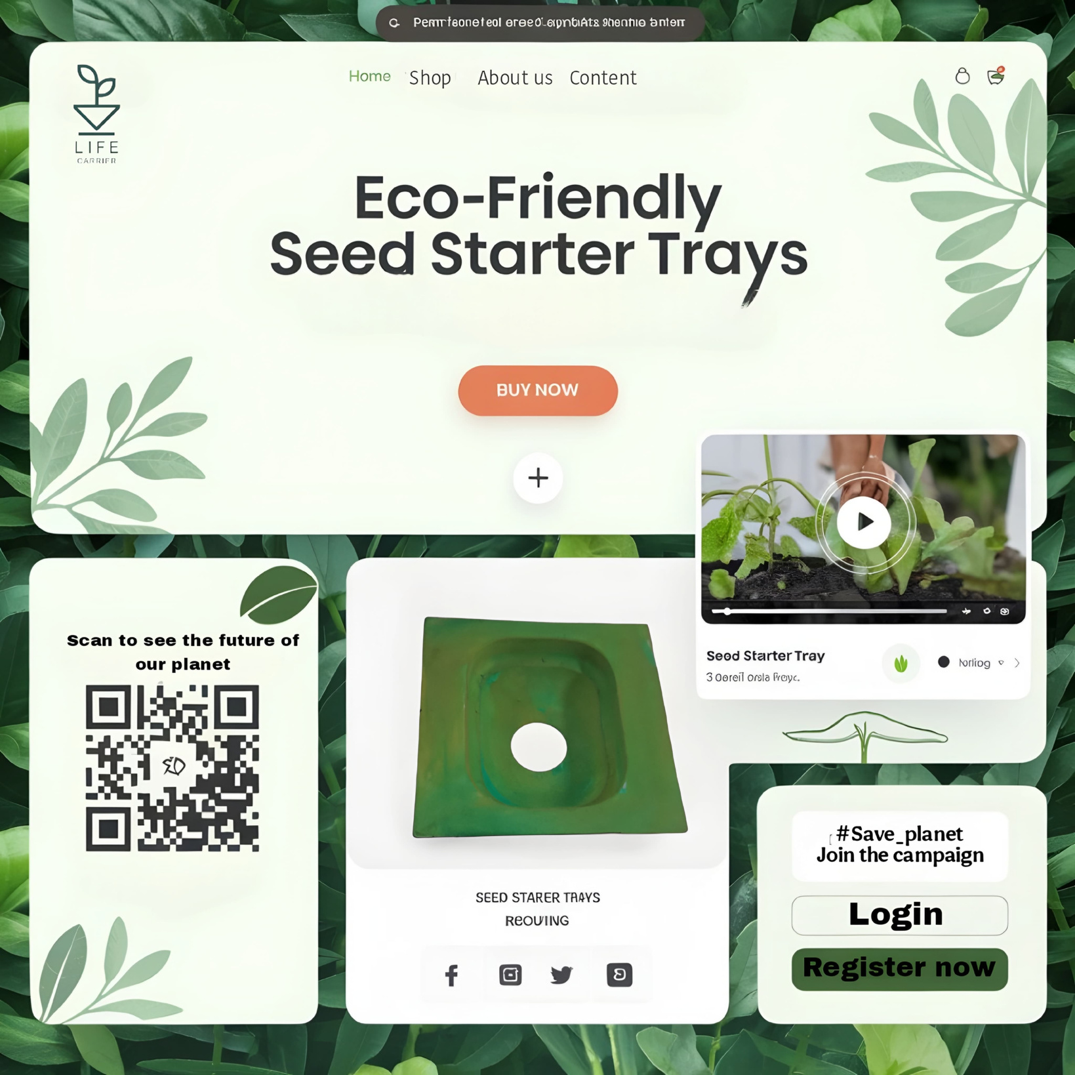
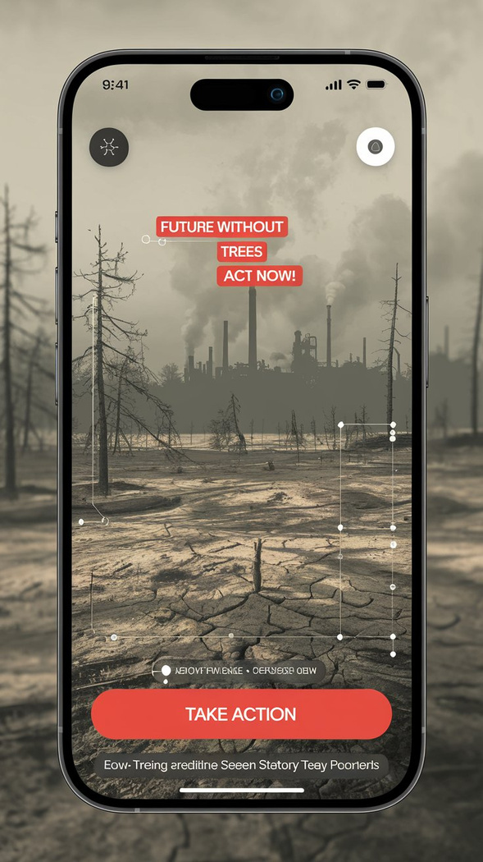

Slide 24
BIG IDEAS
Plant-and-Grow Campaign:
Encourage users to participate in the "1 Million Plants Challenge."
Participants share photos of their planting journeys using the Life Carrier tray, tagging #GrowWithLifeCarrier.
2.Eco-Champions Club:
Reward loyal customers with exclusive discounts and eco-gardening tips.
Create an online community where customers can exchange gardening advice and stories.

Slide 25
BIG IDEAS
Marketing Campaign: "Mark Your Milestone" with Life Carrier
The "Mark Your Milestone" campaign by Life Carrier aims to celebrate significant life events—such as graduations, engagements, births, new jobs, and more—by encouraging customers to commemorate these moments with a special collection of flowering and fruiting plants. Each plant serves as a living reminder of these milestones, allowing consumers to watch their memories grow alongside their plants.
The aim of this campaign is to allow the customers to have a deeper emotional connection with their plants and Life carrier, making it a perfect gifting option for your loved ones.
Encourage users to share their milestone moments with Life Carrier plants using the campaign hashtag #GrowYourMilestone. This user-generated content (UGC) will create a community of shared experiences, where customers can post photos of their plants alongside their milestones
The "Mark Your Milestone" campaign , completely changes the way we view plants in gifting, promoting a culture where individuals would grow past overconsumption and choose more memorable, personal and sustainable gifts like their favorite flowering plant for their loved ones. In-home gardening becomes a family bonding activity where families come together to plant their new milestone.

Slide 26
BIG IDEAS
Collaboration with Afforest -join forces to promote sustainable gardening and home forestation, leveraging each brand's strengths to amplify their shared vision of a greener planet. This partnership will provide consumers with tools and knowledge to create thriving mini-forests and sustainable gardens at home.
"My Mini Forest Starter Kit" featuring biodegradable trays, native plant seeds, and step-by-step guides to growing mini-forests. A success story could highlight a family transforming their backyard into a biodiversity-rich haven with Afforest's guidance and Life Carrier's tools.
Together, Life Carrier and Afforest inspire a shared journey toward a greener planet.

Slide 27
WHY LIFE CARRIER WILL SUCCEED
Reasons for Success:
Addresses a Clear Need: Rising demand for eco-friendly gardening products.
Sustainable and Practical: Combines environmental benefits with ease of use and affordability.
Strategic Digital Marketing: Leverages influencer partnerships, SEO, and interactive campaigns to reach the target audience.
Closing Statement:
"Life Carrier: The eco-friendly revolution your garden needs. Join us in nurturing life, naturally!"

Slide 28
THANK YOU

